Slide 1
System Development Methods CT00046-3-2
System Analysis – Part 1

Slide 2
Topic & Structure of the Lesson
System Analysis
Data Analysis
System Specification

Slide 3
Learning Outcome
At the end of the module, you should able to:
Explain the tools and techniques used for data analysis and discuss the various requirements in system specification.

Slide 4
Learning Outcome
At the end of the module, you should able to:
Analyze and design different views of a system using tools and techniques.

Slide 5
Key Terms you must be able to use
If you have mastered this topic, you should be able to use the following terms correctly in your assignments and exams:
Systems Analysis Techniques
Analysis Tools
Analysis Outcomes
System Specifications and Requirement.

Slide 6

System Analysis
System Analysis
Systems analysis is a problem solving technique
Decomposes a system into its component pieces for the purpose of the studying how well those component parts work and interact to accomplish their purpose
Involves Data Gathering, Data Analysis, Creating Specification
Data Analysis
A process of inspecting, cleaning, transforming, and modeling data with the goal of discovering useful information, suggesting conclusions, and supporting decision-making.

Slide 7

Process of Data Analysis
Collecting and storing data
Cleaning data
Analyzing data
Creating output information
Conclusion of analysis
System Specification

Slide 9
IS Project Research Steps (Product Based Projects)

Slide 10

Data Collections and Compilation for Analysis
Traditional methods
Interviews, questionnaires, literature reviews, etc.
Big Data
Stream, Batch, Iterative
Using Sensors - IOT devices
Traffic cameras, satellites, recording devices, etc.
Online collections
Auto capturing of online transitions
Statistics from internet traffic (real time) and cookies
Data storage
Databases
Data Warehouse and Datasets

Slide 11
Data Analysis process
Data Compilations
Merging data form different sources
Data Cleaning
Removing errors invalid data , redundancy, empty / incomplete data
Data Associations
Looking for relations and patterns within/between data
Data Visualization
Presenting data in tabular, graphical, chart, etc.
Conclusions
Result of analysis.
Helps in creating System Requirements Specifications (SRS)

Slide 12
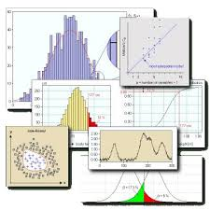
Output of Data Analysis
New knowledge
Summary Table / Charts
Final Facts and Figures
Conclusion
System Specifications / SRS

Slide 13
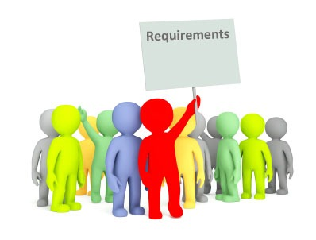
System Specification
Finalized output of System Analysis
Contains detailed information of the system to be built
Mainly contains various Requirements such as;
Functional Requirements
Non-Functional Requirements
Technical Requirements
User Requirements
Interface Requirements
Business Requirements, etc

Slide 14
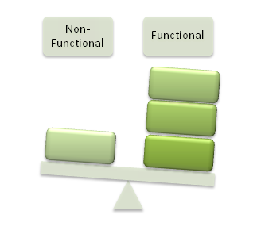
Functional Requirements
The vital function of a system and its components.
Described as a set of inputs, the behavior that the system is supposed to accomplish.
Defines ‘WHAT’ the system is supposed to do.
Ex;
Main calculations that need to be performed
Technical details need to be included
Data manipulation and processing

Slide 15

Non-Functional Requirements
Criteria that can be used to judge the operation of a system
define ‘HOW’ a system is supposed to be.
NFR - often concerns the qualities of a system which defines in measurable units.
usability, reliability, and availability, etc
Ex;
The web portal should have a uptime of 99.98%
Bandwidth within the conference should be maintain at minimum of 2MBps at peak hours.

Slide 16

Technical Requirements
Hardware / Software / Environment requirement for the new system to run on.
Often included / merged with Non-Functional Requirement (but better to separate)
Ex;
System should run a Windows Server 2010 and above
The core system should have minimum 4GB of RAM.
The database server should be minim capacity of 2Tb available storage space for the next 3 year

Slide 17
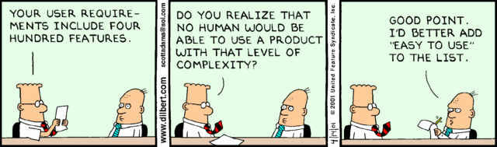
User Requirements
Special requirements from users, for the personal benefits
Often not high priority but developed when developer has enough time/budget.
Ex;
User should be able to print his/her profile from the system.
User should be able to customize the background of the desktop.

Slide 18

Interface Requirements
Special settings for the Graphical User Interface (GUI)
Should be reveled to user in prototype
Ex;
The GUI should be built mostly with the company’s corporate color which is Blue and red.
All main pages in the website should carry the company logo at the bottom right.

Slide 19

Business Requirements
Requirements that needed to be included in the system for the benefit of the company’s business
Comes from the system owners or stakeholders.
Aligns with the company vision & mission, business goals and objectives
Ex;
The web based system should support the business growth for the next five years.
The system should be flexible to support corporate merger in a another 3 years time.

Slide 20

Benefits of System Analysis
Knowledge discovery
Problems source / cause discovery
Obtain proof to support a theory
Verify assumptions with real facts
Filter and keep only important/relevant data
See relationship between facts and figures
View data in a different way to obtain ideas

Slide 21
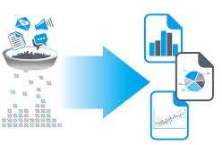
Setbacks of System Analysis
Insufficient data collected
Unreliable and invalid data
Incorrect analysis methods used
Difficult to use analysis tools
Lack of scope / objective of output
Biased inference
Analyst (architect) - lack analysis skills
External issues / hindrance

Slide 22
Question & Answer

Slide 23
Next Session
System Analysis – Part 2 – Data Analysis Techniques and Tools

Slide 24
Tutorial
You are given a task to upgrade Webspace2, to improved Webspace3
a) Discuss what are the methods of data collection would you apply for the above project (and why).
b) The problems that would face when analyzing the data collected for your project.
Write 2 functional and non-functional requirement for Webspace3 (upgrade of Webspace2).

